Slide 1

Network in the Cloud Unit 6
Student : Rodrigo Gomes
Student ID : G200134

Slide 2
Insight to the Scenario
SkyStream Technologies, a leading IT solutions provider, is undergoing a major digital transformation by migrating its network infrastructure to the cloud. As part of the Managed Service Provider (MSP) department, I have been appointed as a Junior Network Cloud Engineer to lead this transition.
This presentation will explore: The cloud architecture design using AWS Virtual Private Cloud (VPC)
How Software-Defined Networking (SDN) is driving this transformation
The implementation of network security, high availability, and scalability
Performance testing and results using AWS CloudWatch and online monitoring tools

Slide 3
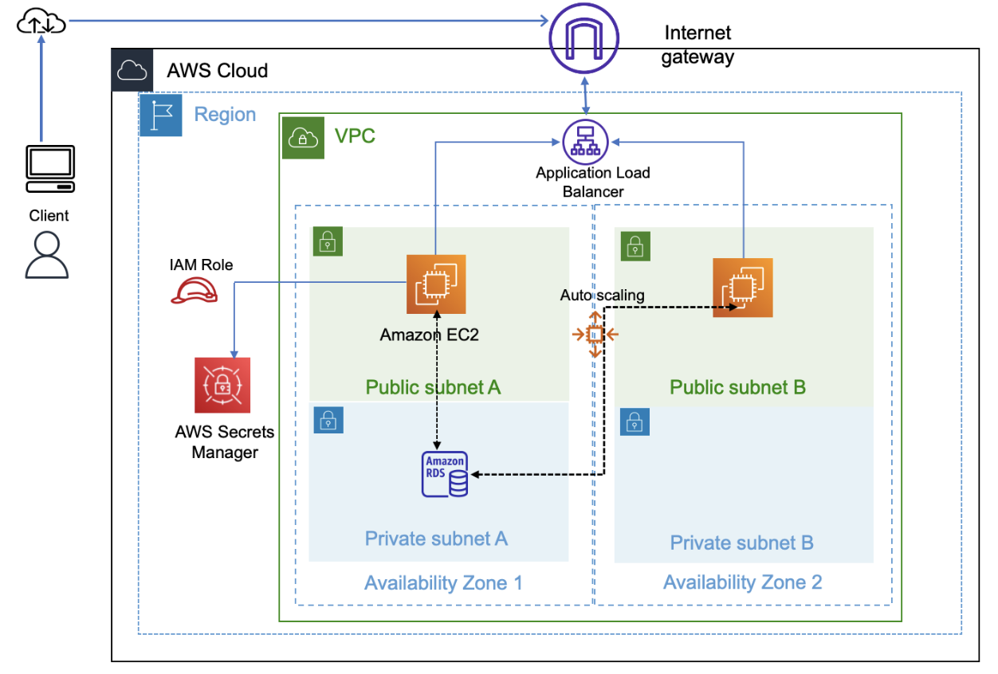
The Final Project Solution
The diagram represents the AWS Cloud Network Architecture implemented for SkyStream Technologies. This setup ensures high availability, security, and scalability using AWS cloud infrastructure.

Slide 4
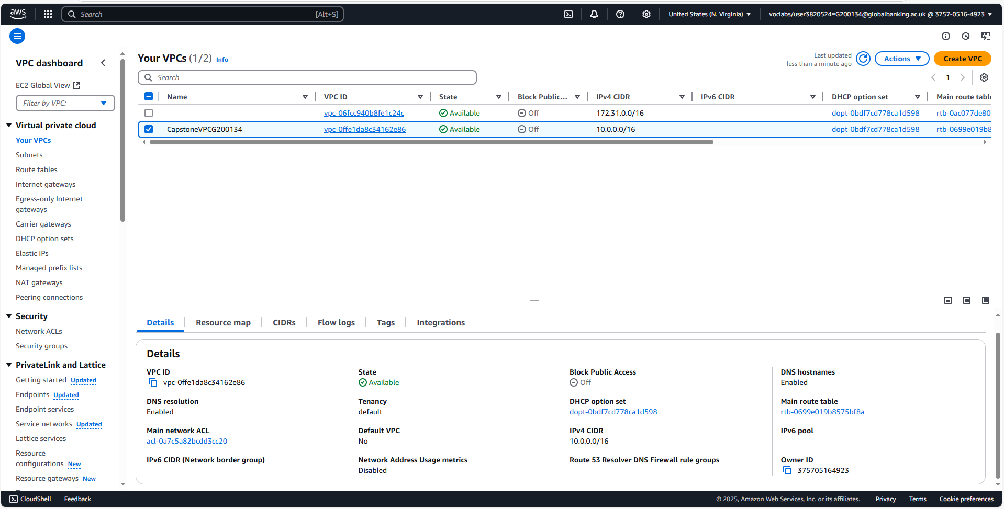
Virtual Private Cloud (VPC)
This VPC forms the foundation of SkyStream Technologies' cloud network, allowing controlled and isolated environments for web applications, databases, and internal services while enabling secure internet access where necessary.

Slide 5
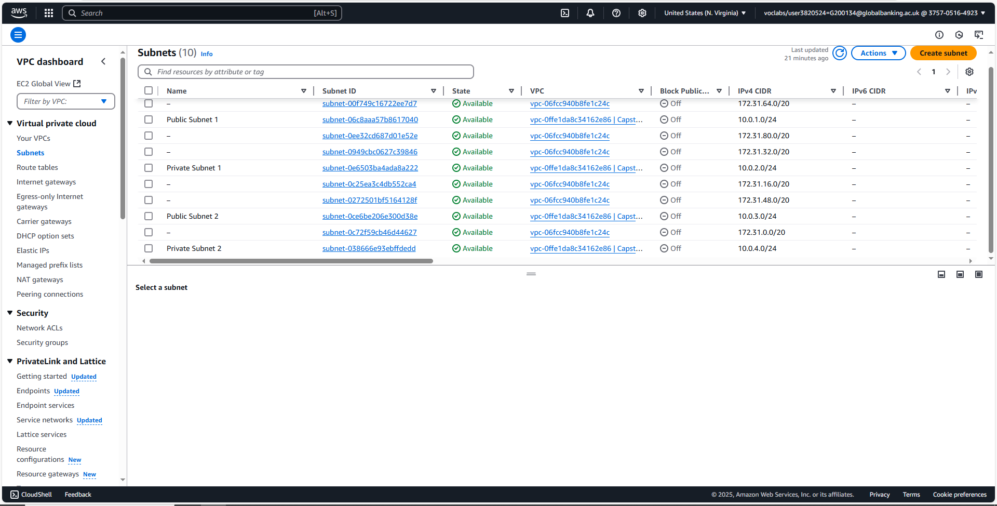
Subnets
This multi-subnet architecture ensures high availability, security, and scalability, allowing efficient distribution of workloads across different AWS Availability Zones while keeping sensitive data isolated.

Slide 6
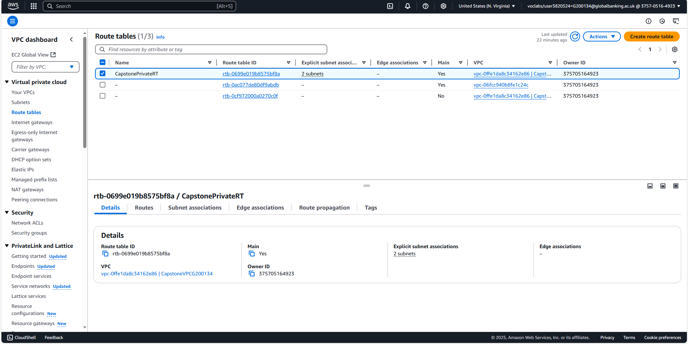
Routing Tables
This image displays the Route Table Configuration for the AWS Virtual Private Cloud (VPC) at SkyStream Technologies. It defines the traffic routing policies for subnets and external network communication.

Slide 7
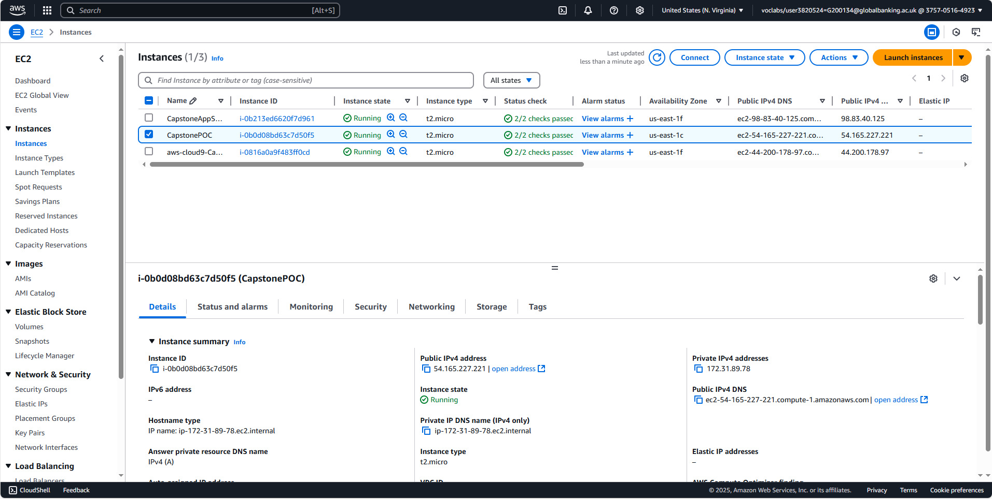
EC2 (Virtual Machine)
This screenshot displays the Amazon EC2 instance setup for SkyStream Technologies' cloud deployment. EC2 instances serve as the computing resources that host applications and services.
Purpose:
Hosts web applications in the cloud.
Ensures high availability and scalability for SkyStream Technologies' services.
Allows secure remote access for management and updates.

Slide 8
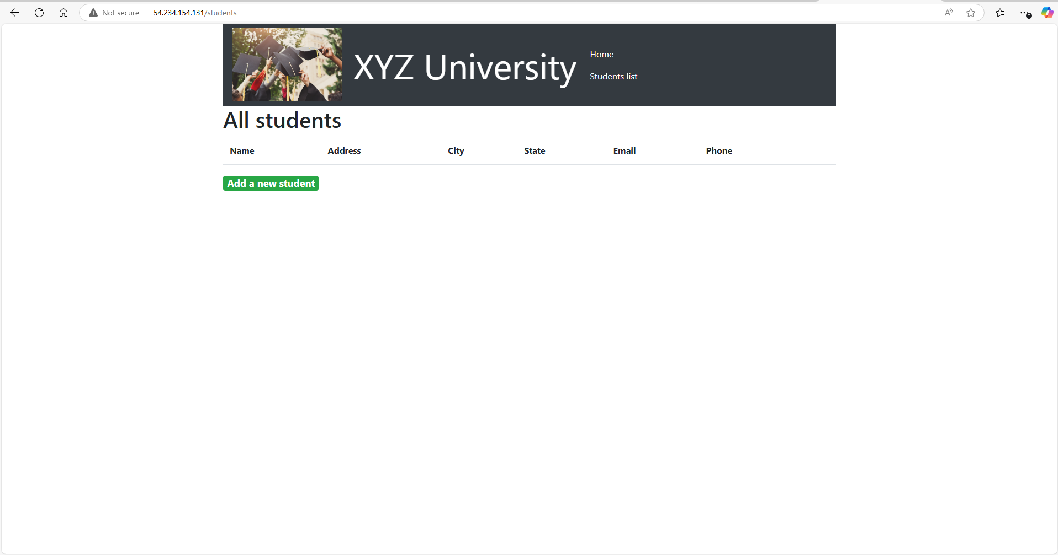
Deployment of Website
This image displays the XYZ University Student Management Web Application, which has been successfully deployed on an AWS EC2 instance as part of SkyStream Technologies' cloud migration project.

Slide 9
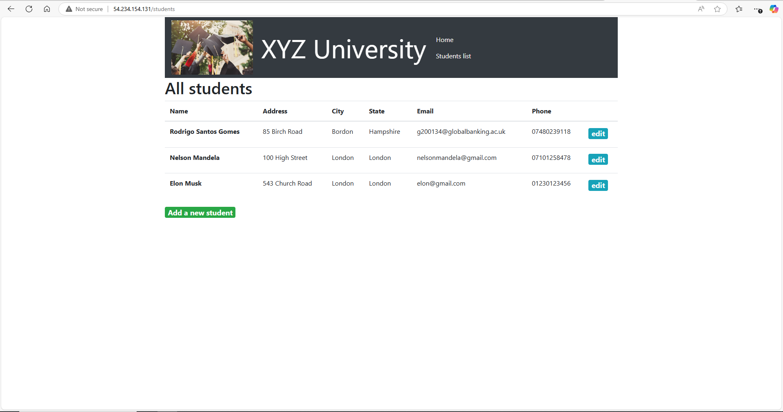
Relational Database System
This screenshot displays the XYZ University Student Management Web Application with student data successfully populated. The system is hosted on an AWS EC2 instance as part of SkyStream Technologies' cloud migration project.

Slide 10
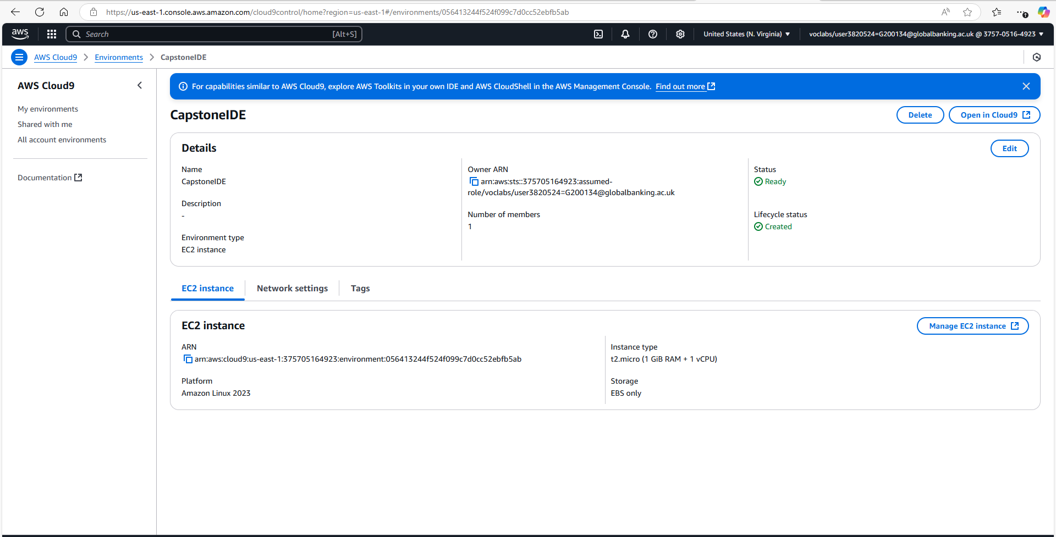
Cloud 9
This image displays the AWS Cloud9 Integrated Development Environment (IDE) setup for SkyStream Technologies' cloud project. AWS Cloud9 is a cloud-based coding environment that allows developers to write, run, and debug applications within AWS infrastructure.

Slide 11
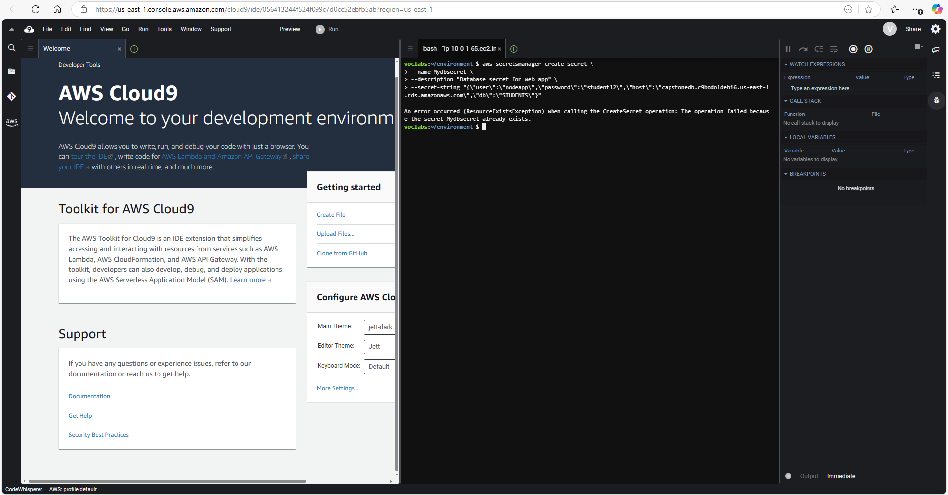
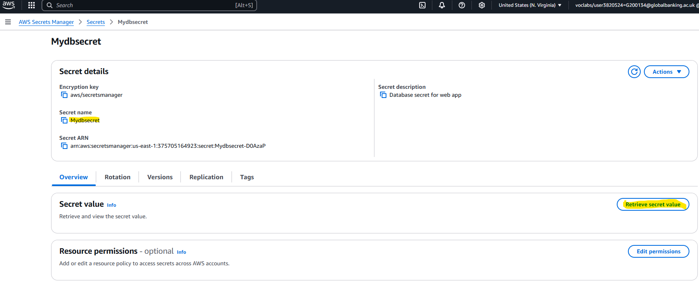
AWS Secret Manager
This image displays AWS Cloud9 in action, showing how AWS Secrets Manager is used to securely store database credentials. Cloud9 serves as a cloud-based development environment for managing infrastructure and applications.

Slide 12
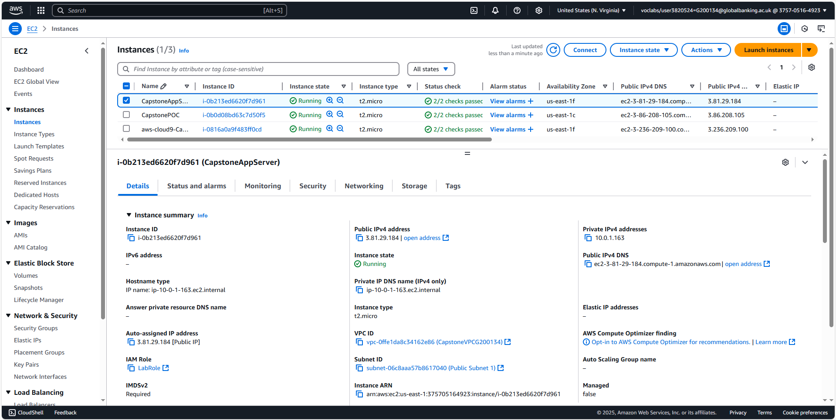
New EC2 (Virtual Machine)
This image displays the Amazon EC2 instance named CapstoneAppServer, which serves as the secondary application server in the cloud infrastructure for SkyStream Technologies.

Slide 13
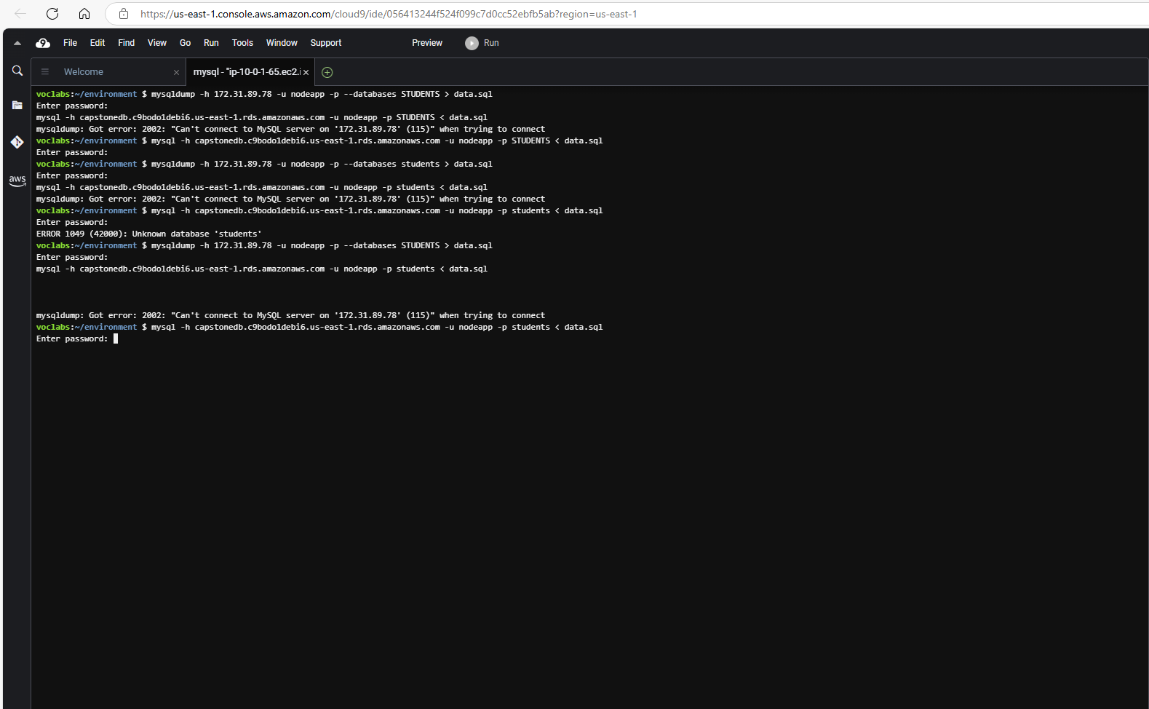
Data Migration
This image displays an attempt to connect to an AWS RDS MySQL database from the AWS Cloud9 environment. The commands executed involve database dumping and restoration, critical for data migration in SkyStream Technologies' cloud infrastructure.

Slide 14
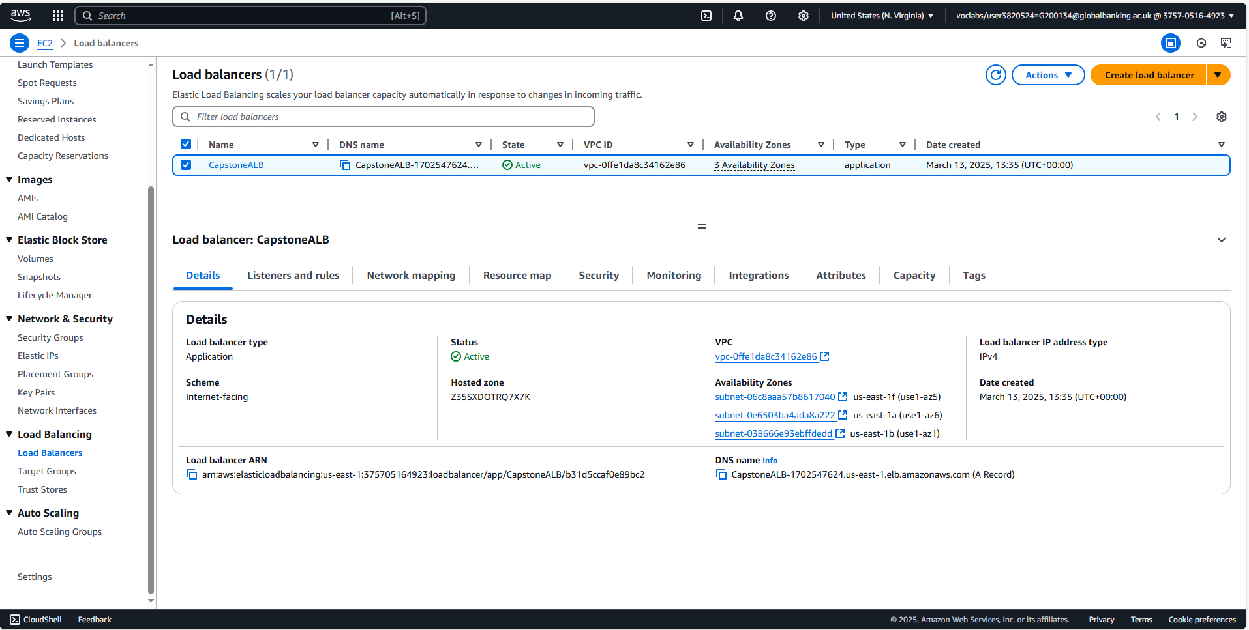
Application Load Balancer
This image displays the AWS Application Load Balancer (ALB) setup for SkyStream Technologies' cloud architecture. The ALB distributes incoming traffic across multiple EC2 instances to ensure high availability, fault tolerance, and scalability.

Slide 15
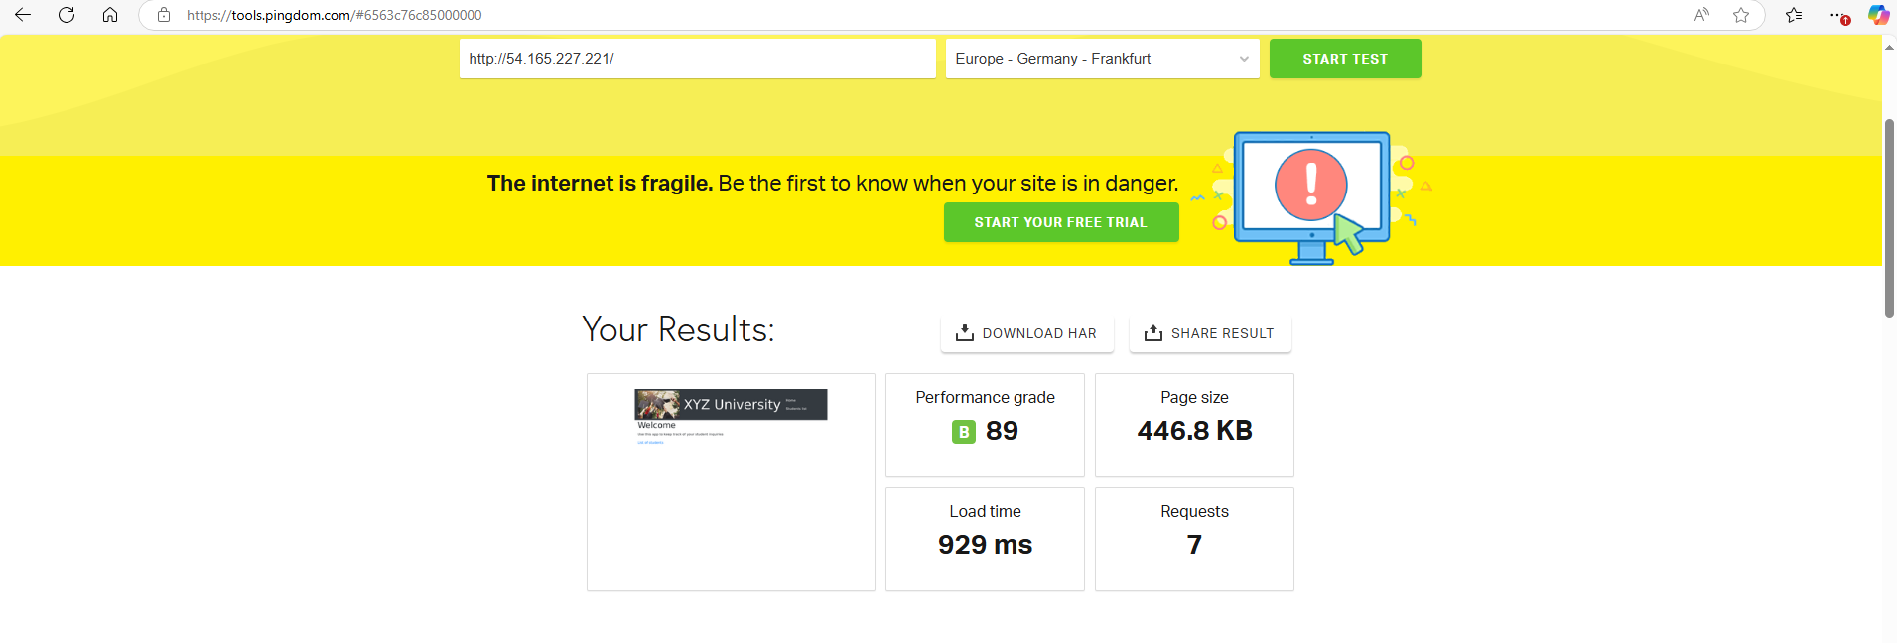
Testing
This image displays the Pingdom Website Speed Test results for the XYZ University Web Application, deployed on an AWS EC2 instance. The test was conducted from Frankfurt, Germany, to evaluate performance, load time, and optimization metrics.

Slide 16
Future Recommendations
To ensure SkyStream Technologies' cloud infrastructure remains secure, scalable, and cost-efficient, the following key recommendations are proposed:
Security Enhancements: Implement HTTPS, IAM best practices, and database encryption to strengthen security.
Performance Optimization: Use CDN, auto-scaling, and load balancing to improve speed and availability.
Cost Efficiency: Utilize reserved instances, AWS Cost Explorer, and serverless solutions to reduce expenses.
High Availability & Backup: Deploy Multi-AZ RDS, automated backups, and disaster recovery strategies.
Monitoring & Threat Detection: Enable AWS CloudWatch, CloudTrail, and GuardDuty for real-time monitoring.

Slide 17

Thank You

